Slide 1

Object-Oriented Programming

Slide 2
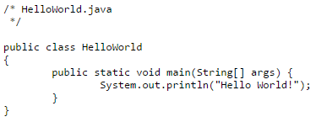
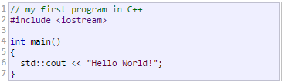

Programming?
Just writing some text in a specific format

Slide 3
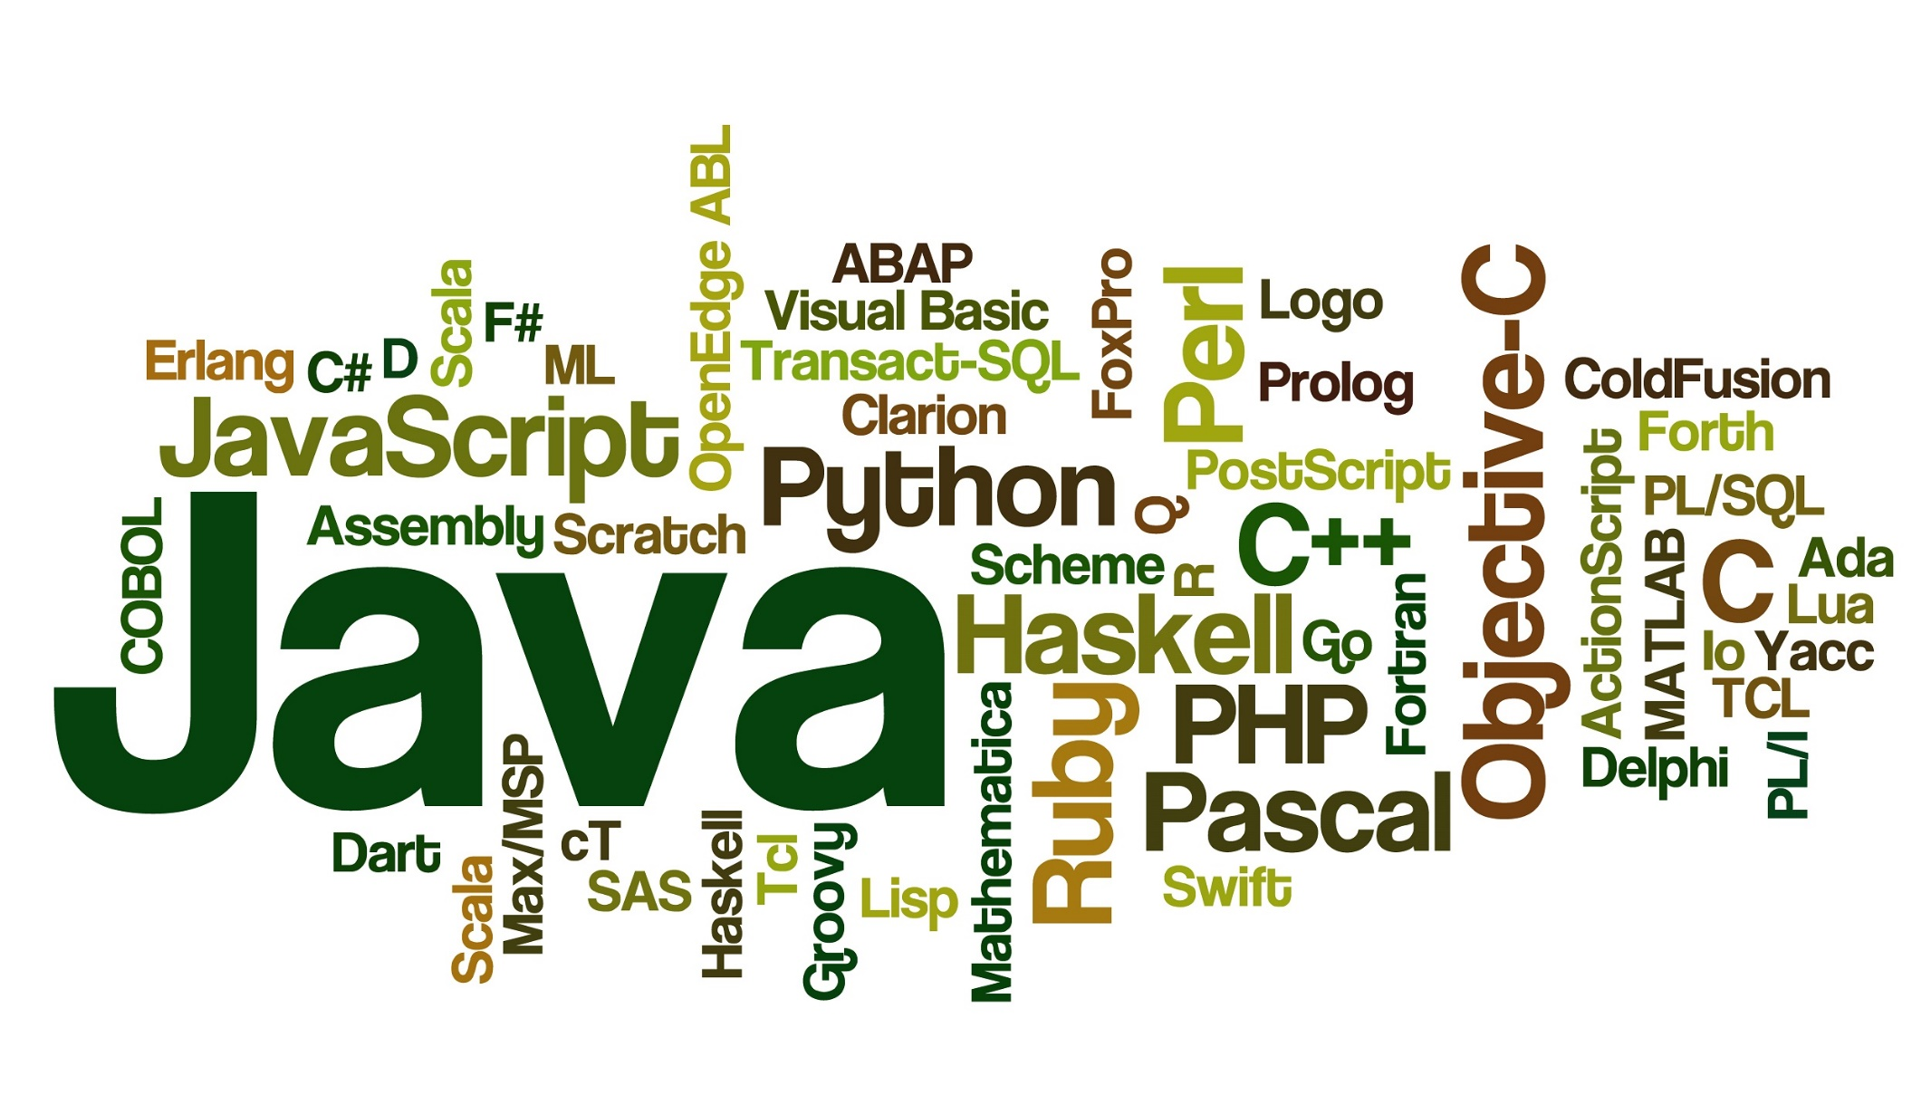
PROGRAMMING LANGUAGES

Slide 4
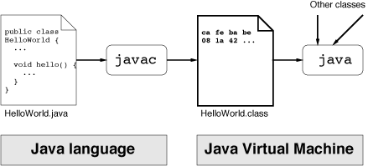
So, What is TRICK HERE?
A compiler/interpreter does the actual job!
Read text file, interpret the contents, output another file more understandable by machines, less understandable by us ☺

Slide 5
Modern IDES
Previous slide is not a modern day practice.
At least only computer engineers likes to do it.
Now we have IDEs (Integrated Development Environment)
Providing
Text editors
Compilers
And many other useful features

Slide 6
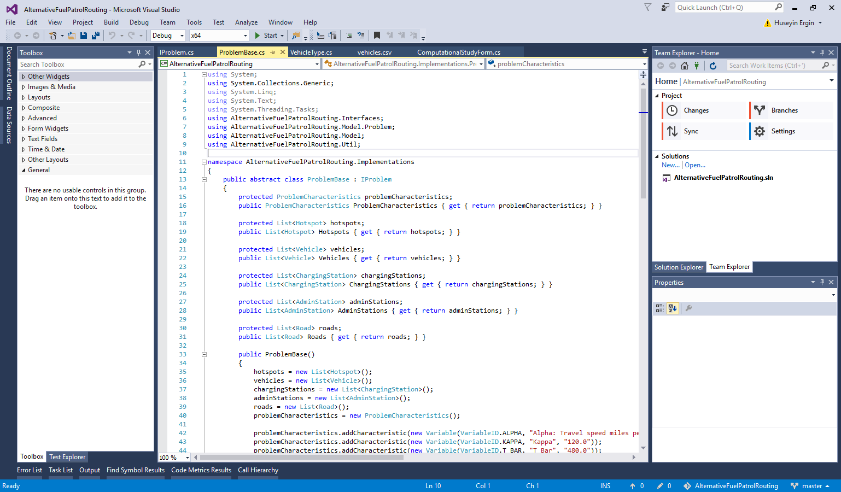
IDE SAMPLES
Notes:
Visual studio

Slide 7
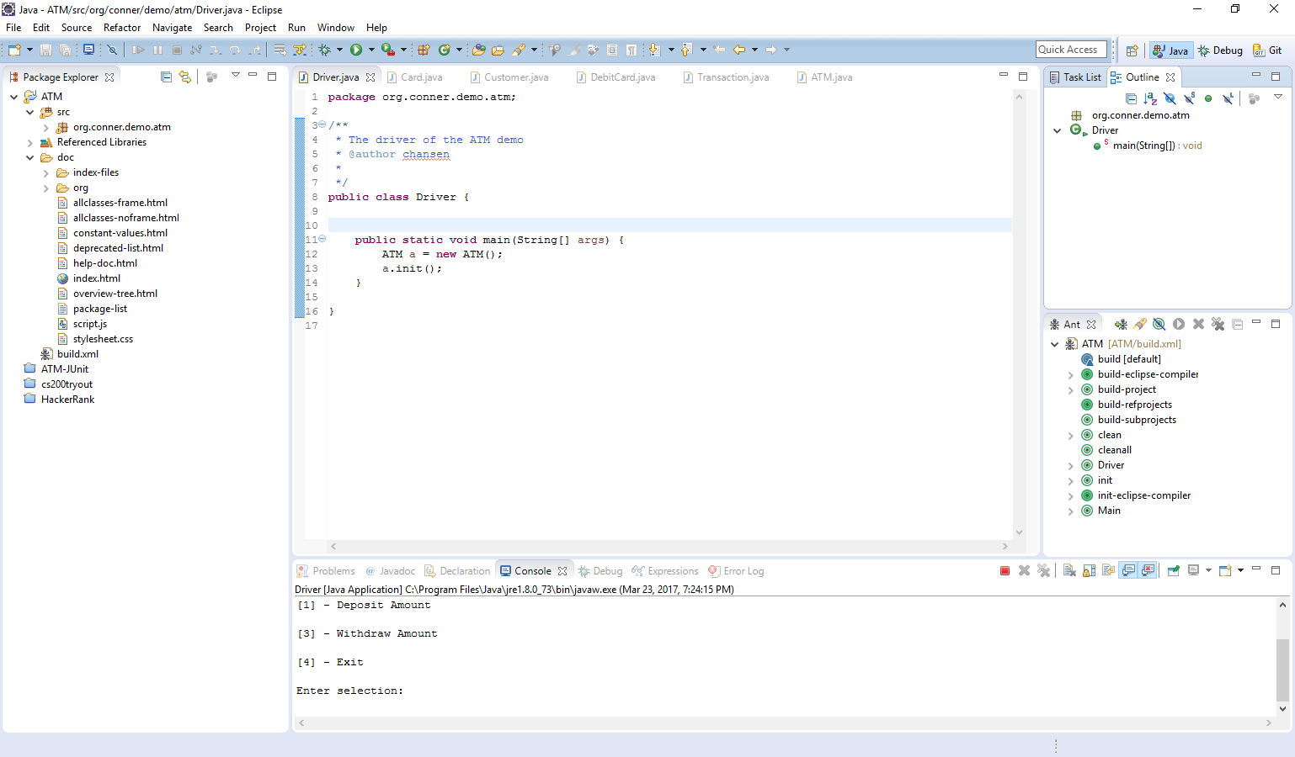
IDE SAMPLES
Notes:
Eclipse

Slide 8

What is a PROGRAM?
Just some sequential lines to instruct the computer what to do!
Notes:
When we come back.

Slide 9
What is a PROGRAMMING LANGUAGE?
Provides the developer useful constructs
Defining variables
Looping
Conditionals
Many more…
And advanced constructs
Data management
Memory management
Networking
Scheduling
Notes:
It provides us the developers useful constructs to instruct the computer!

Slide 10
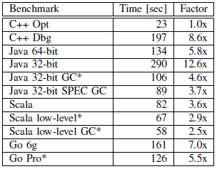
WHICH LANGUAGE
According to Google*:
The fastest language is C++
BUT
If you don’t optimize your code, you may end up slower than other languages
See C++ Dbg vs other languages
*Loop Recognition in C++/Java/Go/Scala by Robert Hundt - Google

Slide 11
Of Course…
The programs are not small any more!
Chrome browser: 17 millions LOC (lines of code)
Office 2013: 45 millions LOC
Facebook: 60 millions LOC
You can’t just put all the lines sequentially and expect someone to understand!
First, it is impossible.
Second, it is torture.
Of course we need extra structures to handle the complexity

Slide 12
When things get bigger - Modularize
We can define methods in order to make our program mode readable.
Notes:
We can modularize by using functions. Grouping some of the stuff.
So our programs will be more understandable.

Slide 13
MODULARIZE EVEN MORE
We can make this method parametric.
And use parametrized version whenever needed.
Notes:
We can go even further and make more modular by creating parametrized functions.

Slide 14
FUN PART
Spoiler alert:
You will see some code in action!

Slide 15
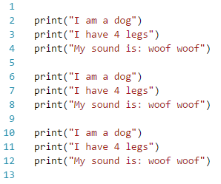
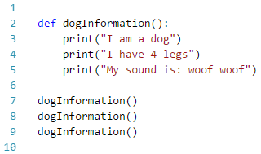

ENOUGH OF THE LINES, GIVE ME SOMETHING
I want to do this 3 times?
Notes:
I want to do it three times.
What to do?

Slide 16
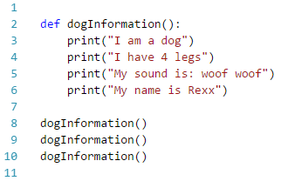
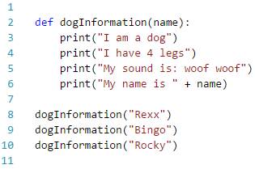
MODULARIZING - Parametrized
Notes:
Parametrize the name

Slide 17
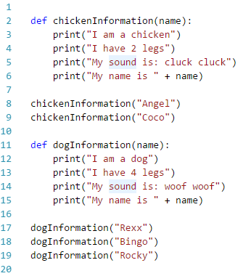
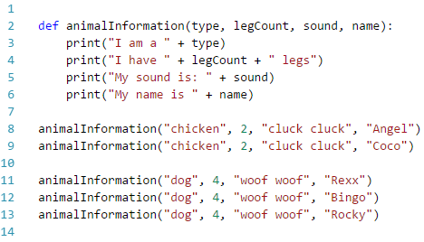
MODULARIZING – More Parametrized
We still have a lot of repetitions.
Notes:
Now I want to print another animal information
Tadaa chicken
But I didn’t like something in this code.
We have a lot of repetition here and here.
Why should I write 2 everytime?

Slide 18
EPIPHANY
Wouldn’t it be nice if there is a special structure that:
Knows what kind of an animal it is.
Knows how many legs it has.
Can make sound by itself.
Has a name.
So that, I don’t have to write them every time.

Slide 19
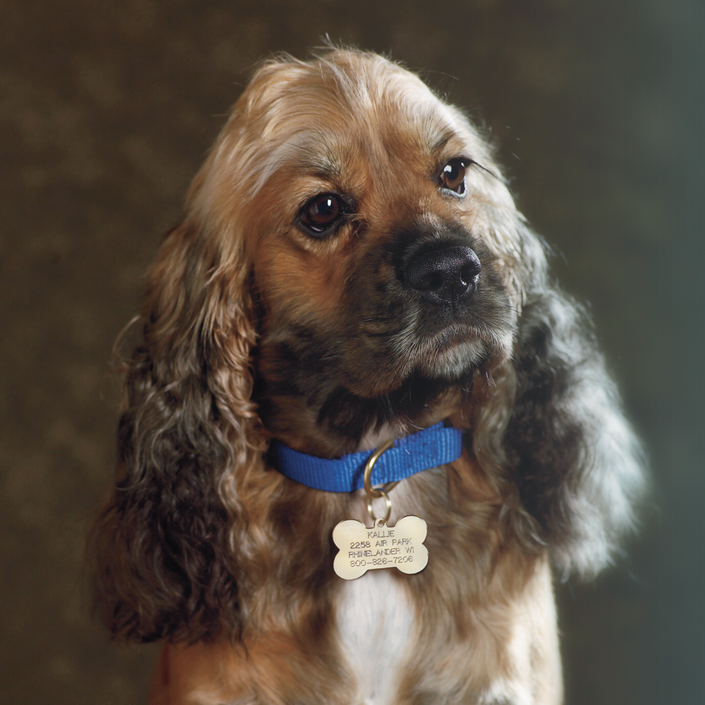
EPIPHANY
So, we are basically talking about a dog?
It has a name, knows how many legs it has, can make sound itself.
Notes:
So we are basically talking about a dog?
Has name, knows how many legs it has, can make sound itself.

Slide 20
EPIPHANY
So we need to mimic the real life in our applications.
Because a program is for the developer to write/understand easily, not for the computer.
“First, we want to establish the idea that a computer language is not just a way of getting a computer to perform operations but rather it is a novel formal medium for expressing ideas about methodology.
Thus, programs must be written for people to read, and only incidentally for machines to execute.”
Harold Abelson*
*Author of the renowned Structure and Interpretation of Computer Programs book (with Jay Sussman)
Notes:
Forget what I said about programming languages!

Slide 21
EPIPHANY
Wouldn’t it be nice if there is a special structure that:
Knows what kind of an animal it is.
Knows how many legs it has.
Can make sound by itself.
Has a name.
We already have a system for this.
Object-oriented programming.
A.k.a.
Object-oriented methodology
Object-oriented paradigm
Object-oriented design and analysis
Notes:
Let’s come back to our point.

Slide 22
Object-oriented programming
Basically, we have objects that know:
Its attributes
Its operations
Whenever, I need a square or triangle, I will use them.
I ask for information and they answer.
Side
Area = side*side
Height
Base
Area = (height*base)/2
height
Side
base

Slide 23
Object IDENTIFICATION
Car, glass, bike, bus
All can be objects
Dog, cat, person, laptop
Again, can be objects
Running, walking, making a sound etc… ?
No, these are not objects!
These are actions (methods/operations) that can be done by an object
Like a Rectangle can compute its own area
A people can run.
Side, height, numberOfLegs etc… ?
No, these are not objects!
These are properties (attributes) that can be owned by an object
Like side of a Rectangle.
Numberoflegs of a Person.

Slide 24
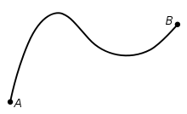

Everything can be an object
It just depends on the context!
Distance between two cities can be an object
If it is the main focus of the problem.
Relationship between two people can be an object
If we are solving a problem about this.

Slide 25
Let’s identify some objects
Company XYZ is a manufacturing company that produces cartoon action figurines for big entertainment companies.
This company is using an inventory and tracking system.
The inventory system keeps track of how many of each figurine is stored in each warehouse.
Figures are stored in cases.
Clients order the figurines and the cases are eventually shipped to clients.

Slide 26
Objects Identified
Company XYZ is a manufacturing company that produces cartoon action figurines for big entertainment companies.
This company is using an inventory and tracking system.
The inventory system keeps track of how many of each figurine is stored in each warehouse.
Figures are stored in cases.
Clients order the figurines and the cases are eventually shipped to clients.

Slide 27
Any More?
Company XYZ is a manufacturing company that produces cartoon action figurines for big entertainment companies.
This company is using an inventory and tracking system.
The inventory system keeps track of how many of each figurine is stored in each warehouse.
Figures are stored in cases.
Clients order the figurines and the cases are eventually shipped to clients.

Slide 28
ANOTHER EXAMPLE
An ATM needs to allow a customer to identify themselves
Each customer has a debit card and PIN
Customers should be presented with some kind of menu to help direct them.
Customers can perform two transactions:
They should be able to deposit funds
They should be able to withdraw funds upto $200
These funds must be withdrawn in units of $20
The ATM should tell some banking software to update the customers’ account at the end of transaction
The ATM should also give the customer some record of the transaction.

Slide 29
Objects IDentified
An ATM needs to allow a customer to identify themselves
Each customer has a debit card and PIN
Customers should be presented with some kind of menu to help direct them.
Customers can perform two transactions:
They should be able to deposit funds
They should be able to withdraw funds upto $200
These funds must be withdrawn in units of $20
The ATM should tell some banking software to update the customers’ account at the end of transaction
The ATM should also give the customer some record of the transaction.
This PIN number object seems redundant.
We can make it a property of either customer or debit card.
This small design decision will make a lot of difference.
Notes:
Maybe this PIN number doesn’t need to be an object. It can just be an attribute of either the customer or a debit card.

Slide 30
Object-Oriented Languages
Most modern languages support object-orientation now
Java
C++ (C with classes)
C#
Python
Even Fortran
Any many more

Slide 31

A REPRESENTATION SYSTEM
Various languages support object-orientation.
So, there should be a way to represent this system regardless of the language we use.
UML is here.

Slide 32
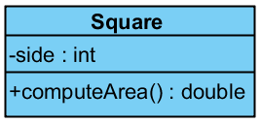
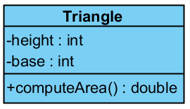
UML BASICS - CLASS
Side
Area = side*side
Side
Height
Base
Area = (height*base)/2
height
base

Slide 33
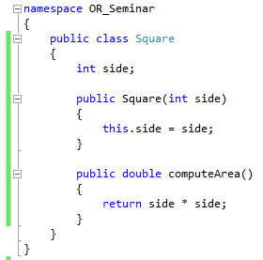
CLASS IN C#

Slide 34

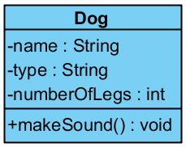


WAIT
We were talking about objects, now what the heck is a class?
Time to define the relation between these two.
Basically, we get the properties that all the dogs have and define a Dog class with them.
A class is a generalization of objects.
And objects are just instances of the class.

Slide 35
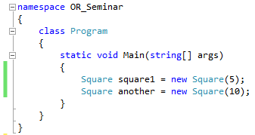
OBJECTS FROM CLASSES
Constructor
Now we can create objects
From classes
Using a constructor
Notes:
And this mysterious piece in the code does this creation.
It creates an object from a class.

Slide 36
CONCEPTS & DESIGN PRINCIPLES IN OBJECT-ORIENTED PROGRAMMING
Concepts:
Encapsulation
Inheritance
Polymorphism
Cohesion
Coupling
Principles
Open-Closed Principle
Don’t Repeat Yourself Principle
Single Responsibility Principle
Liskov Substitution Principle
Interface Seggregation Principle
Dependency Inversion Principle
If we don’t use these concepts and obey these principles, we aren’t coding in proper object-oriented way.

Slide 37
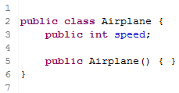
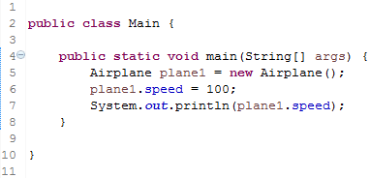
ENCAPSULATION
Protecting your information from being used incorrectly.
Problem?
What if speed if out of limits?
What if we want some adjustments before setting the speed?
Notes:
Now that anyone can change the speed of a plane,
But what if speed is out-of-range? Or invalid? Or maybe you should do just some adjustment to the speed before setting?

Slide 38
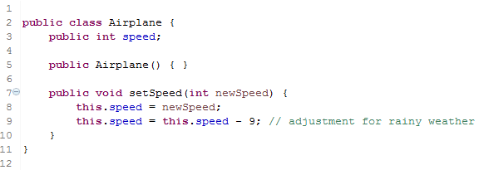
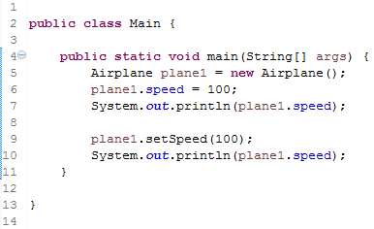
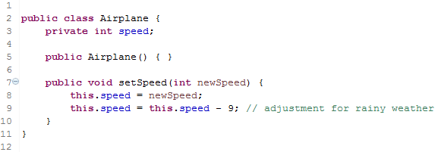
ENCAPSULATION
Solution?

Slide 39
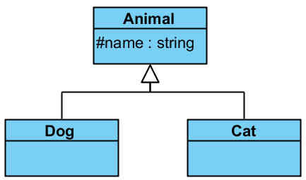
Inheritance
A class’ inheriting properties and operations from another class.
Both Dogs and Cats have names, right?
Then, why shouldn’t we create a base class Animal for them?

Slide 40
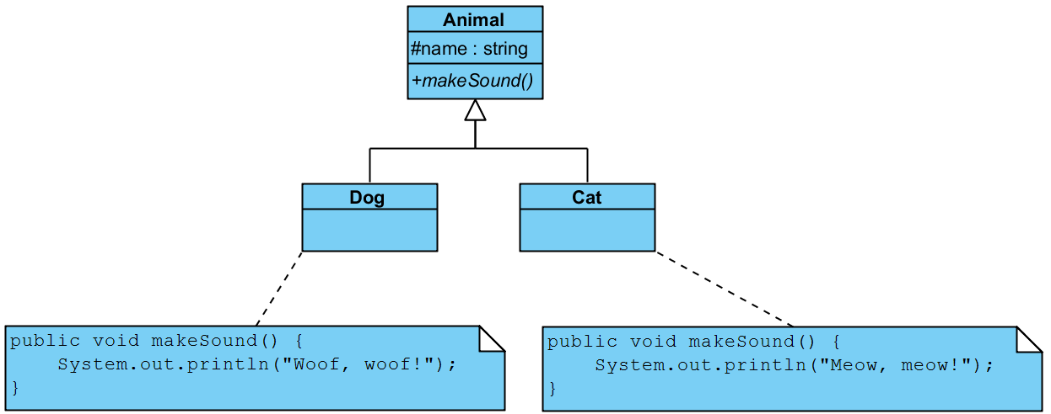
Polymorphism
Having different forms of same operations.

Slide 41
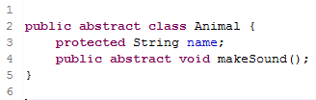
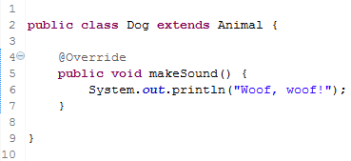
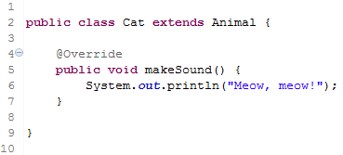
Polymorphism

Slide 42
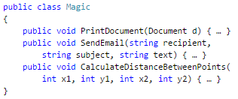
Cohesion
A class should do one thing really well, and shouldn’t try to do or be someone else.
Strong cohesion means: all methods of a class are more or less related.
A Math class which can compute sqrt, power, exp, cos etc.
If a class has methods for:
Printing a document
Sending an email
Working with trigonometric functions
How should we name it? Complicated, right?

Slide 43
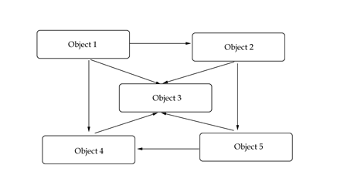
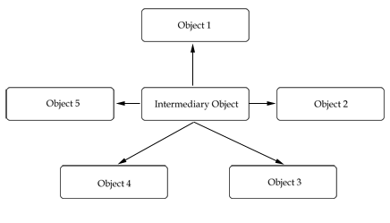
Coupling
The extent to which classes depend on one another.
A class should work independently without being coupled too much to other classes.
This helps us making them modules and available on demand.

Slide 44
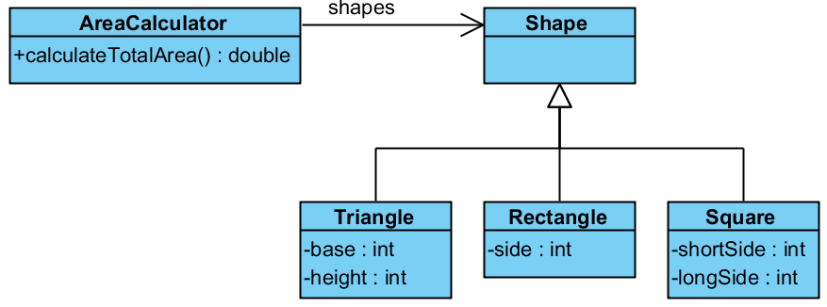
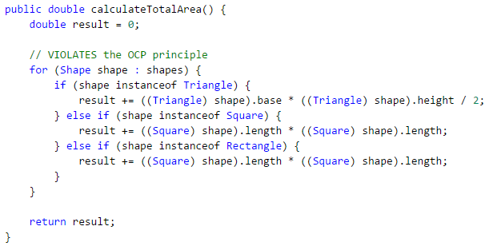
Open-Closed Principle
Classes should be open to extension, but closed for modification.
Problem?
Whenever we add a new shape, we should modify the calculateTotalArea method.
Notes:
Whenever we add a new shape to the system, we should go and modify this method of area calculator.

Slide 45
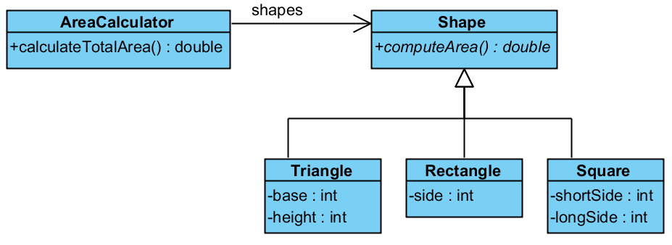
Open-Closed Principle
Solution?

Slide 46
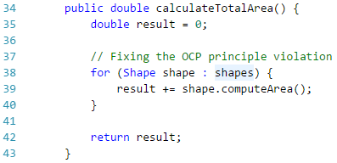
Open-Closed Principle

Slide 47
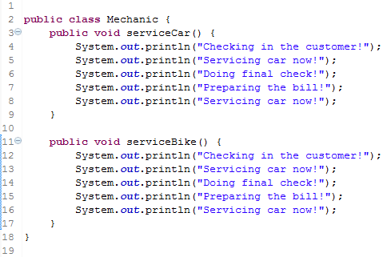
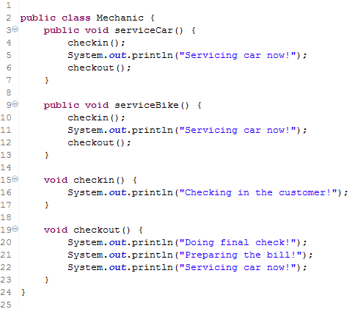
Don’t Repeat Yourself Principle
Avoid duplicate code by abstracting common things out and placing them in a single location.

Slide 48
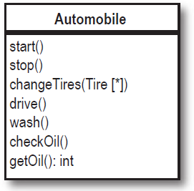
Single Responsibility Principle
Every object in the system should have one responsibility
Each object has only one reason to change
Doesn’t mean it should only have one method
Usually the violation of this principle can be identified by asking:
Can _______ _________ itself?
Example: Can Automobile changeTires itself?
If it is no, it is violating SRP.

Slide 49
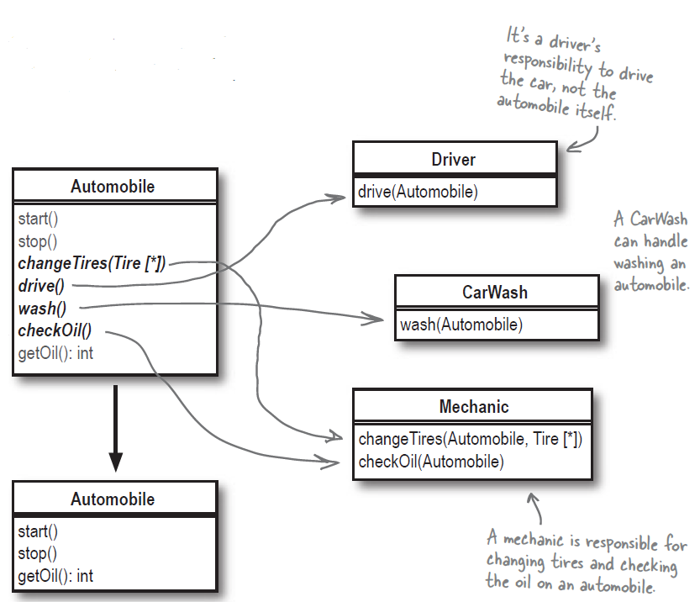
SINGLE RESPONSIBILITY PRINCIPLE

Slide 50
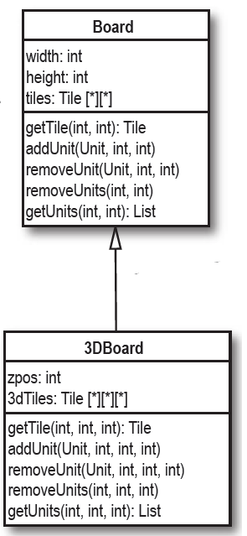
LISKOV SUBSTITUTION PRINCIPLE
Sub-classes must be substitutable for their base classes.
If you inherit from a wrong base class, then you can’t do this.
Problem?
We inherit from the board, but we hardly use its methods or properties. Because they don’t match with 3D board.

Slide 51
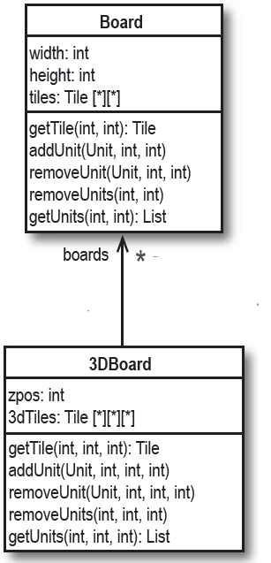
LISKOV SUBSTITUTION PRINCIPLE
Sub-classes must be substitutable for their base classes.
If you inherit from a wrong base class, then you can’t do this.
Solution?

Slide 52
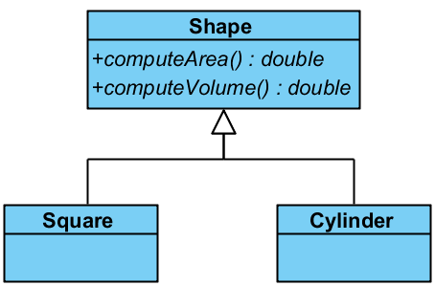
Interface Seggregation Principle
A class should never be forced to have some unnecessary methods.
Problem?
We force Square to have a computeVolume method, which it doesn’t have!

Slide 53
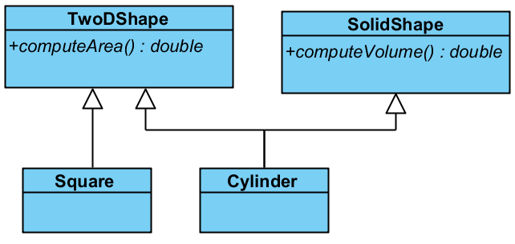
Interface Seggregation Principle
Solution?

Slide 54
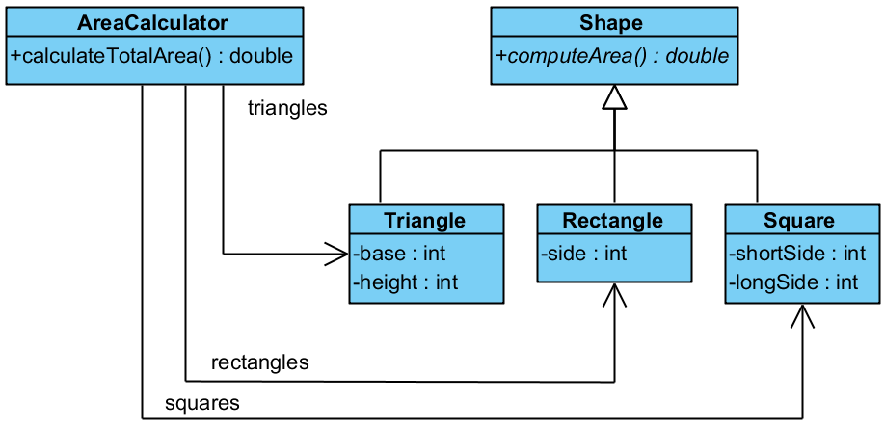
Dependency Inversion Principle
Entities must depend on abstractions/interfaces rather than actual classes.
So that they can be decoupled.
Problem?
We have to treat each shape separately. Because we have links to actual classes.

Slide 55
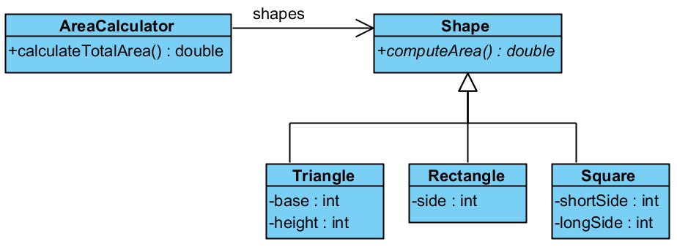
Dependency Inversion Principle
Solution?

Slide 56
What CAN WE ACHIEVE FROM THIS? Some IDEAS
Read data from various sources but our program can stay the same
Easily switch between different algorithms on the same data
Make any module work independent from others
Make the output of the project independent from the data or the algorithm itself
Test the correctness of each class independently
Model the problem in a human-readable way
And most importantly, reuse and maintain your application better.
Future-proof.

Slide 57
Other Tools & Technologies in order to improve Your Programming
Versioning (github, bitbucket etc.)
Version your code in order to access any change you made (and backup)
Unit tests
Test each unit independently, be sure it is doing whatever it is supposed to do.
Most languages have support for this. Look for it.
Documentation (Doxygen, Javadoc etc.)
Always comment your code. You can even produce automatic documentation from these comments.
Diagramming
Your code may not be understandable, but your diagrams will be. Learn UML Class diagram and use it in your projects.

Slide 58
Conclusion
Object-oriented programming provides very flexible structures for our programs.
It can be applied in many languages, as long as the language supports object-orientation.
If we obey the principles, it will be an actual system.
Otherwise, it is just the same code with classes and additional complexity.
Object-oriented system is not a perfect system and it has its own flaws. But it is still the best system.
Always strive for the best design.

Slide 59

Questions?
Thanks for listening…
For offline questions, find my contact info here: www.objectivelook.net

Slide 60
Some Resources
Object-oriented programming with C# (The book itself is nice and free, chapter 20 is OOP): http://www.introprogramming.info/english-intro-csharp-book/read-online/
For new starters to OOP, this book is fun: https://www.amazon.com/Head-First-Object-Oriented-Analysis-Design/dp/0596008678
Detailed explanation, nicely done, 2 pages (Java):
https://www.ntu.edu.sg/home/ehchua/programming/java/J3a_OOPBasics.html
https://www.ntu.edu.sg/home/ehchua/programming/java/J3b_OOPInheritancePolymorphism.html
Same as above but with C++:
https://www.ntu.edu.sg/home/ehchua/programming/cpp/cp3_OOP.html
Even though, there are a lot of resources. I suggest to work with someone who you can ask questions immediately. Because OOP requires a change of mindset.

